Slide 1
Air Pollution Dashboard
By Aarti Nimhan
Student Id- 801098198

Slide 2
Dataset Details
Dataset Link:
https://www.kaggle.com/shrutibhargava94/india-air-quality-data
Description:
Due to industrialization and more and more use of vehicles the air pollution is becoming a serious problem all around the world. This dataset provides details about the increasing quantities of hazardous components in the air like Sulphur dioxide, nitrogen dioxide and many more. This data is collected over the past few decades for all major cities in India.

Slide 3
Data Attributes
stn_code : Station code
sampling_date : Date of sampling
State: State
Location: City
Agency
Type : Area category
So2: Sulphur dioxide
No2: Nitrogen dioxide
Rspm: Respirable Suspended Particulate Matter
Spm: Suspended Particulate Matter
location_monitoring_station: location of monitoring area
Date: Date of recording

Slide 4
Tasks

Slide 5
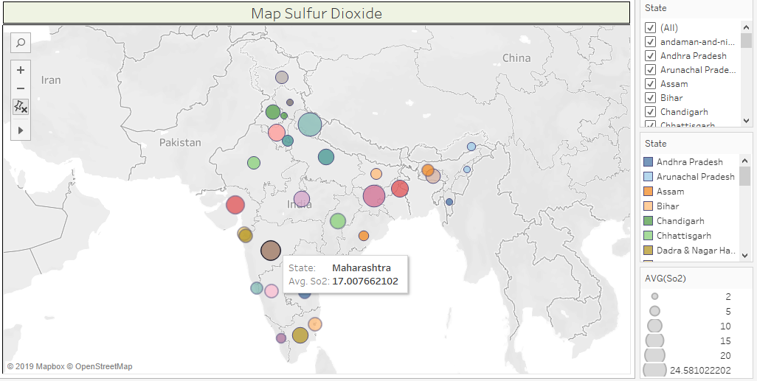
1) Which state has the most Sulphur dioxide pollutants in the air? Which Cities from that State are major contributors?

Slide 6
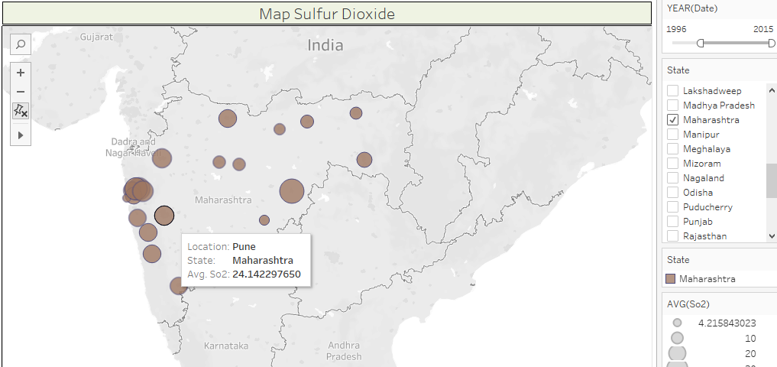
1) Which state has the most Sulphur dioxide pollutants in the air? Which Cities from that State are major contributors?

Slide 7
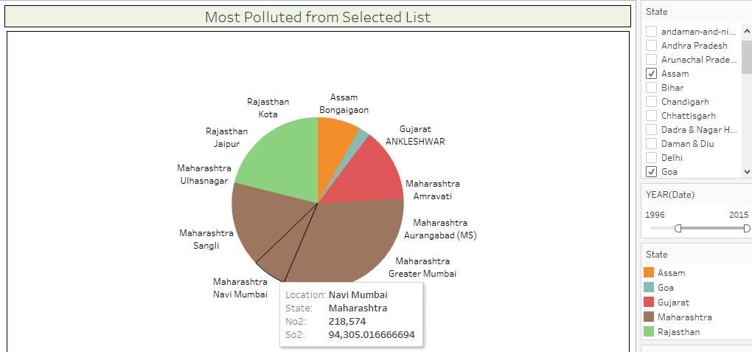
2) Which State has the most polluted air (all pollutants)amongst selected ones and their proportions with respect to one another?

Slide 8
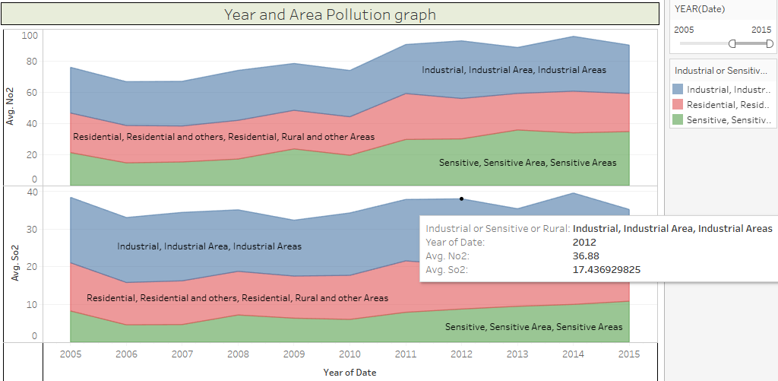
3) How do the quantities of pollutants change with respect to Areas and Time durations?

Slide 9
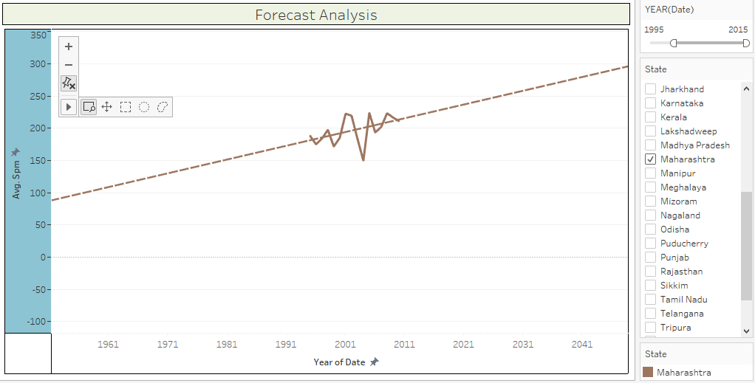
4) What is the Forecasted Trend of the Suspended Particulate Matters(Spm) for the different states?

Slide 10
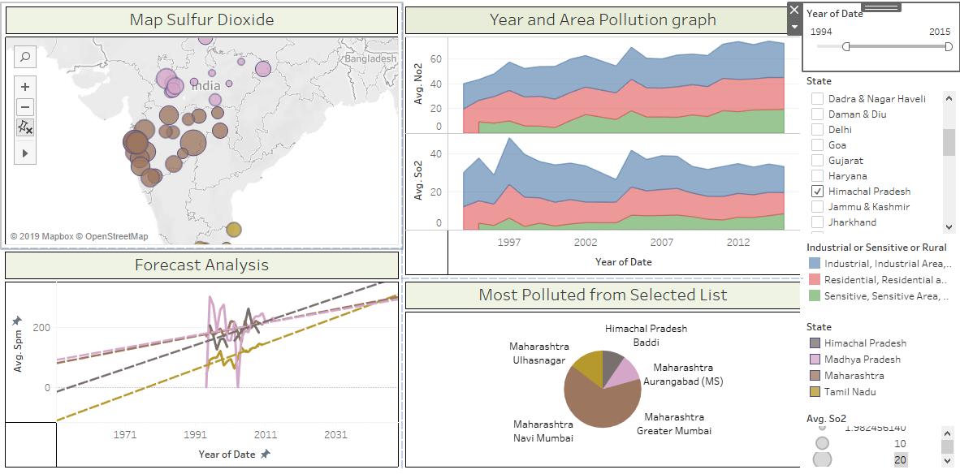
Dashboard

Slide 11
Thank You!

